Slide 1

Group - 3
105122508005 - E.Praveena Krishna
105122508008 - P. Ashritha
105122508016 - G.Niveditha
105122508021 - V.Abhinav
105122508024 - G.Karthik

Slide 2

Predictive Modeling
&
Feature Analysis for Effective Recruitment

Slide 3
Introduction
In today's competitive job market, making the right hiring decisions is critical for organizational success.
The project aims to develop an AI model to enhance candidate selection by using data-driven decisions.
Key aspects include analyzing candidate attributes such as education, experience, and interview scores.
The process involves data preprocessing, feature selection, Statistical Analysis and applying machine learning techniques.
The ultimate goal is to predict the hiring decision and improve precision in selecting the best candidates.

Slide 4

Objective
Assess how feature variables influence hiring decisions by analyzing their relationships with the target variable using Chi-Square tests, T-Tests, and ANOVA.
Identify the most influential features impacting hiring decisions using feature importance analysis.
Develop machine learning models to predict hiring decisions.

Slide 5
Source of the data
The dataset was sourced from Kaggle.
Data Sample

Slide 6
Numerous studies have demonstrated the impact of data-driven approaches on improving recruitment outcomes.
Research has shown that predictive models can significantly enhance the efficiency of hiring processes by identifying top candidates early.
A gap in existing literature is the integration of diverse candidate metrics into a single predictive model.
This study aims to bridge that gap by using a comprehensive dataset to model hiring decisions.
Literature Survey

Slide 7
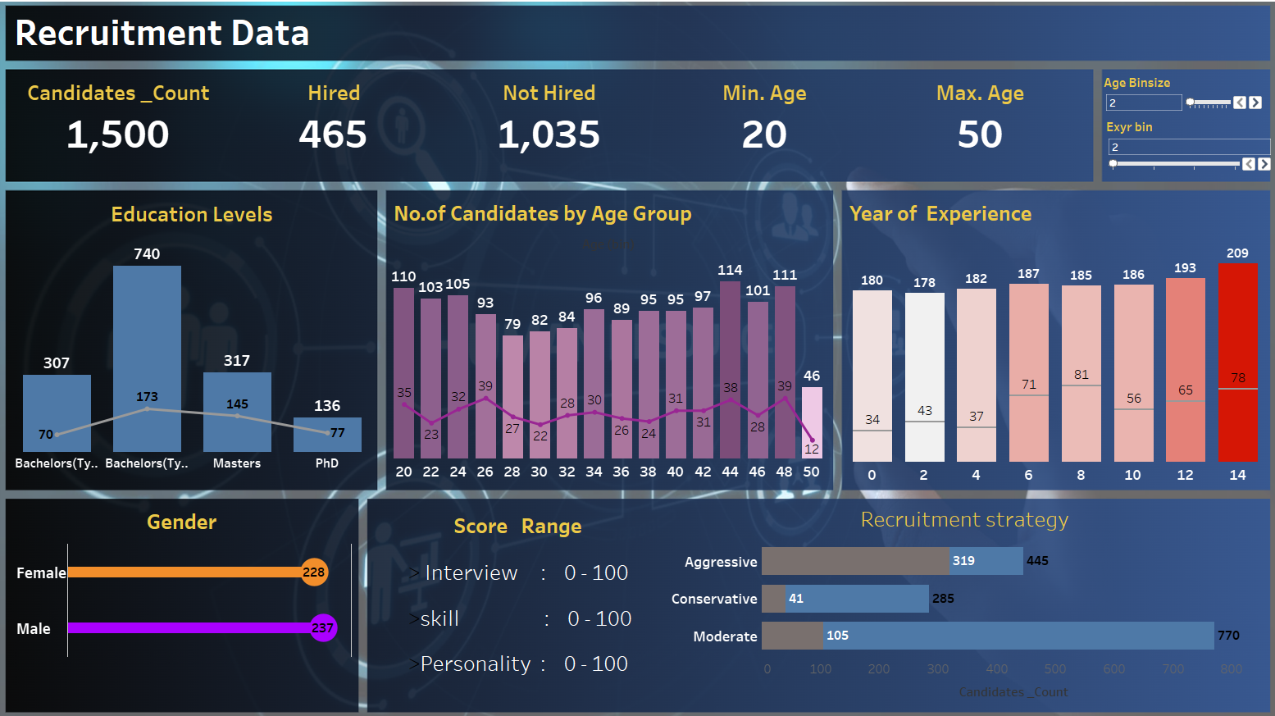

Slide 8
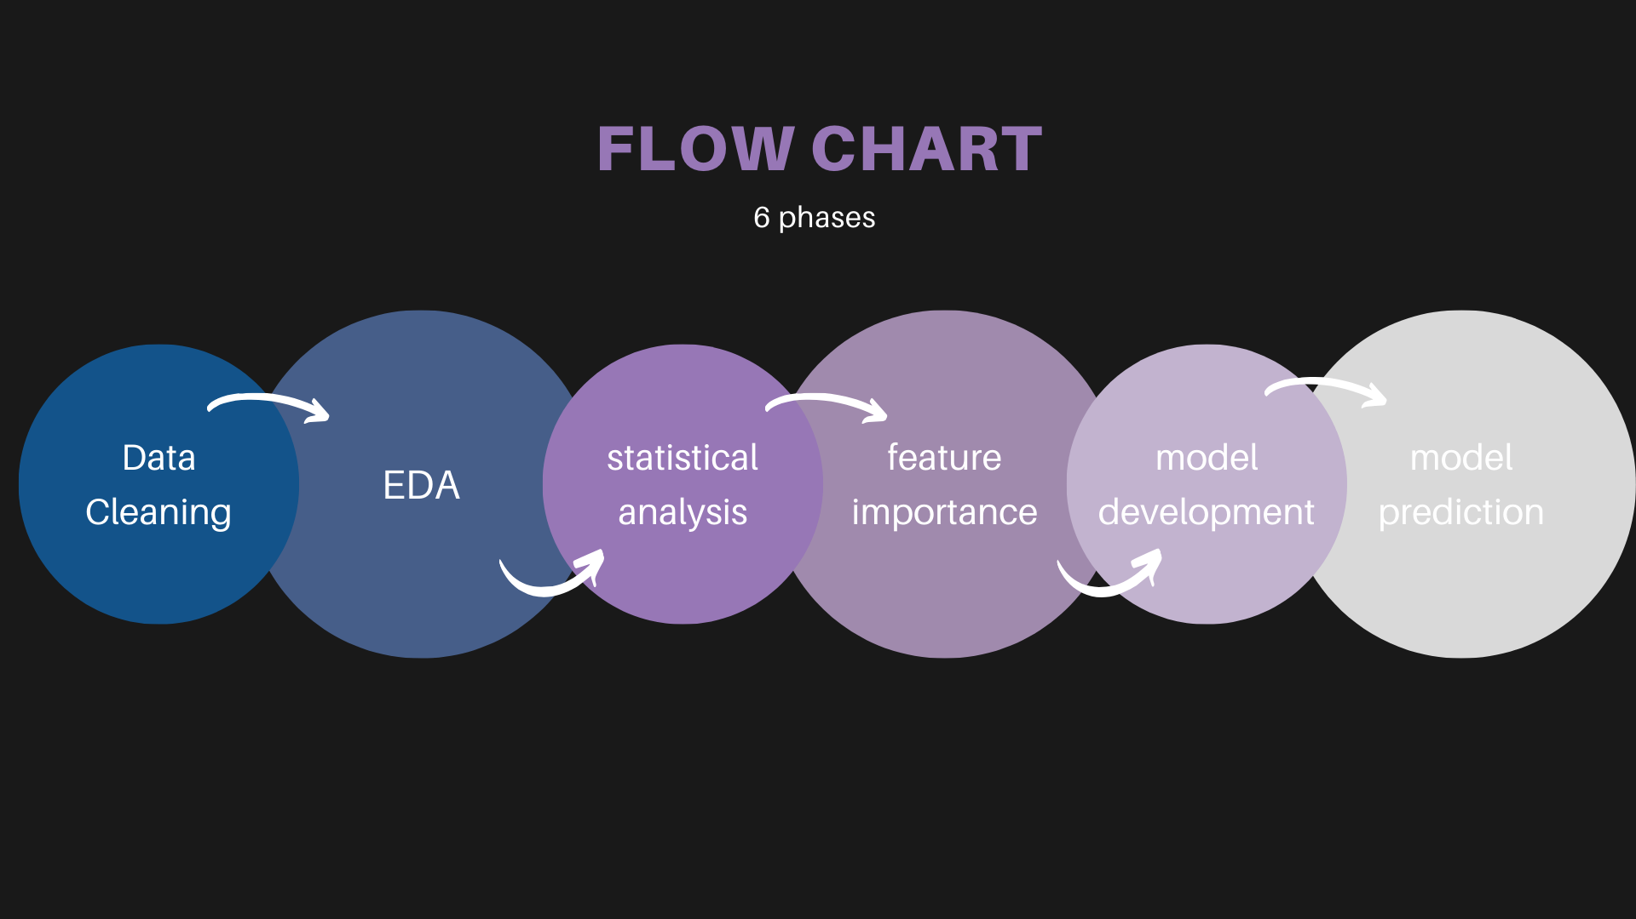

Slide 9
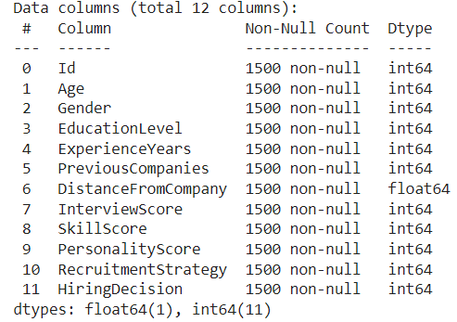
Data Cleaning

Slide 10

Exploratory Data Analysis

Slide 11
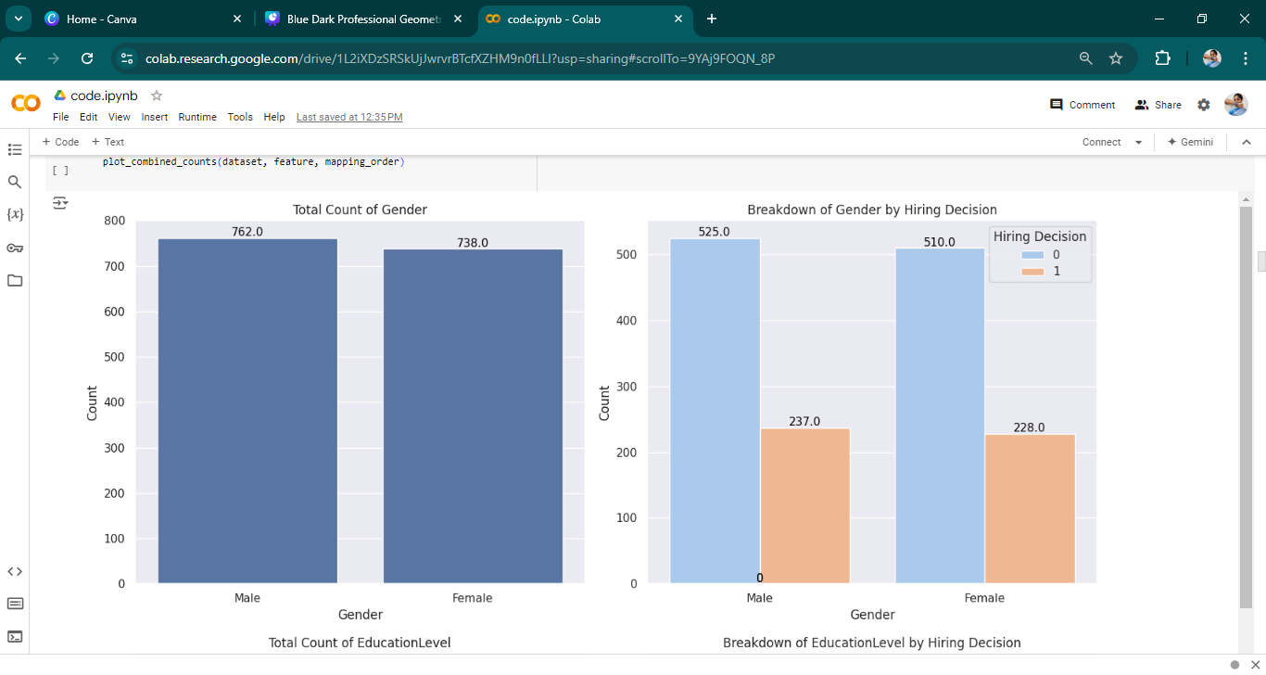

Slide 12
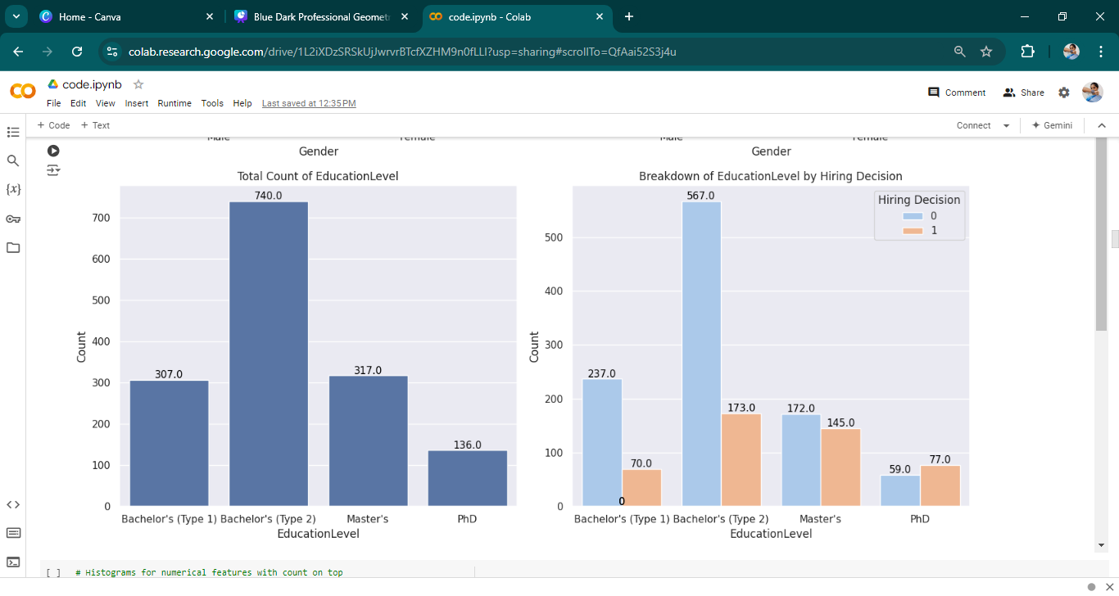

Slide 13
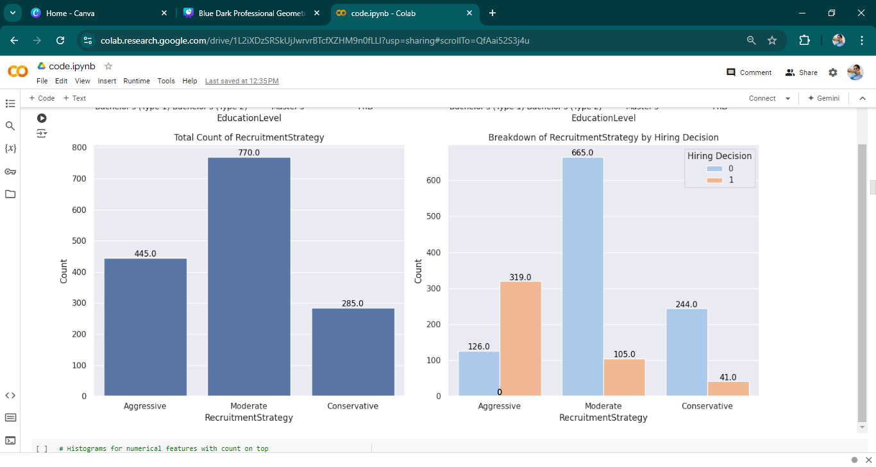

Slide 14
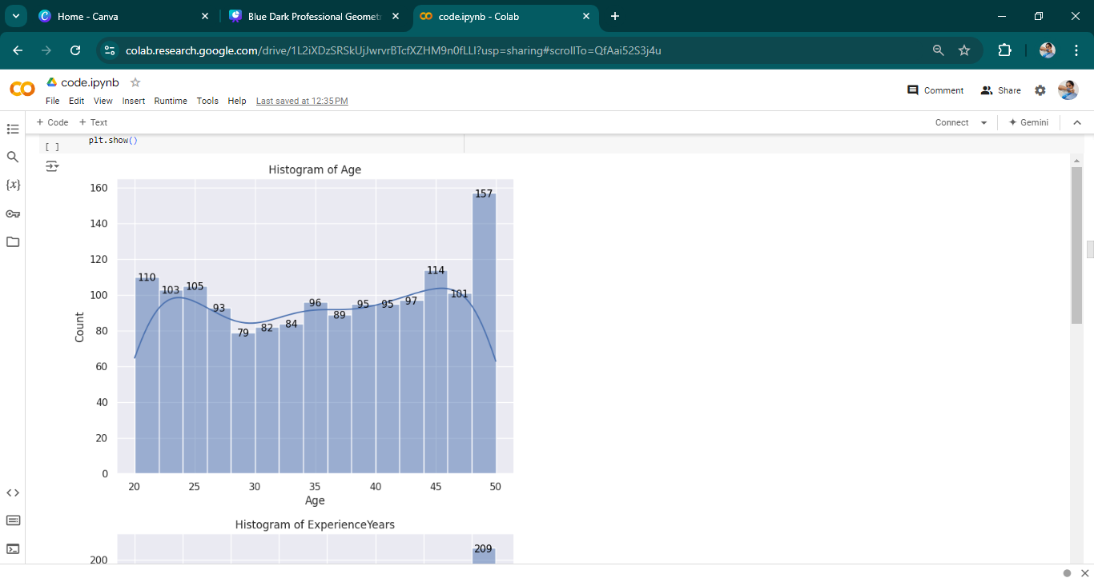
ANALYSIS
The highest age of the the candidates is 50 with a count of 157

Slide 15
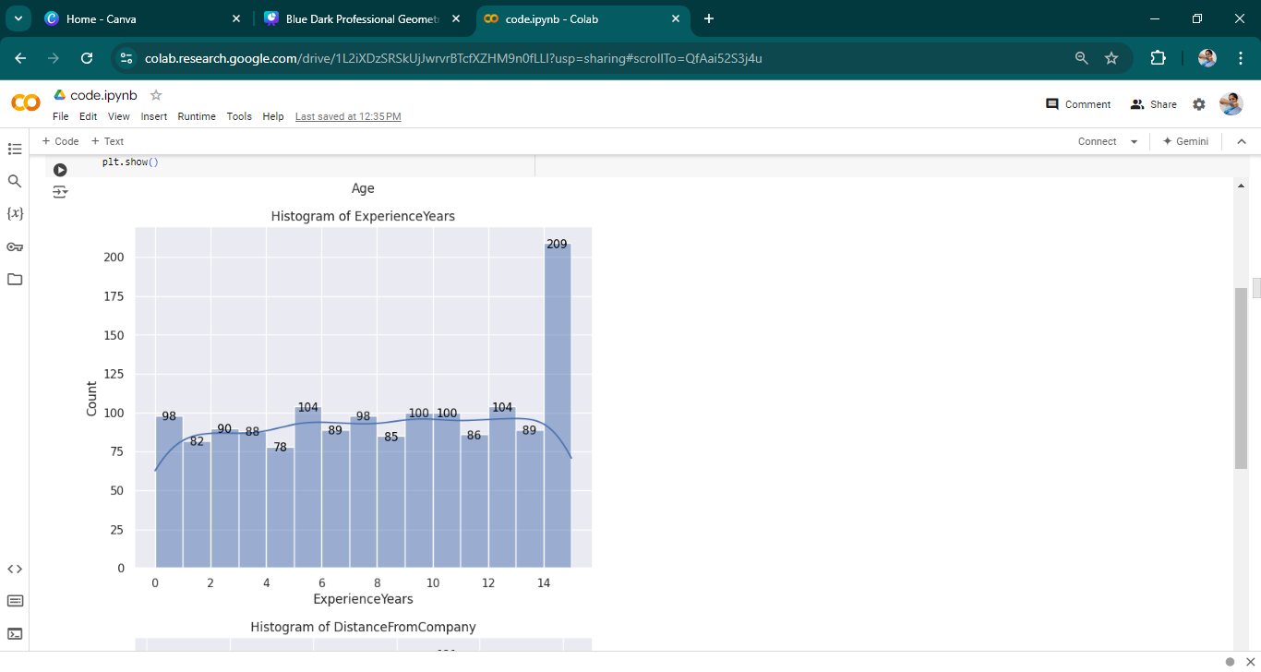
ANALYSIS
The highest years of experience is 14 years with a count of 209 candidates

Slide 16
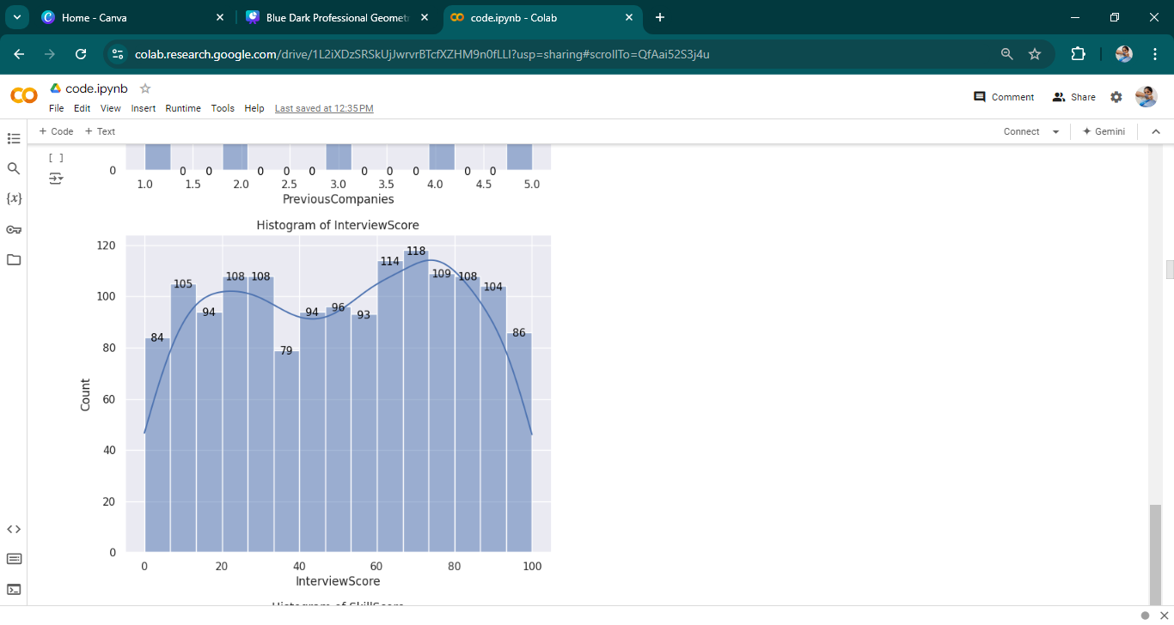
ANALYSIS
The highest interview score is 70 with a count of 118 candidates.
The 2nd highest score is 65 with a count of 114.

Slide 17
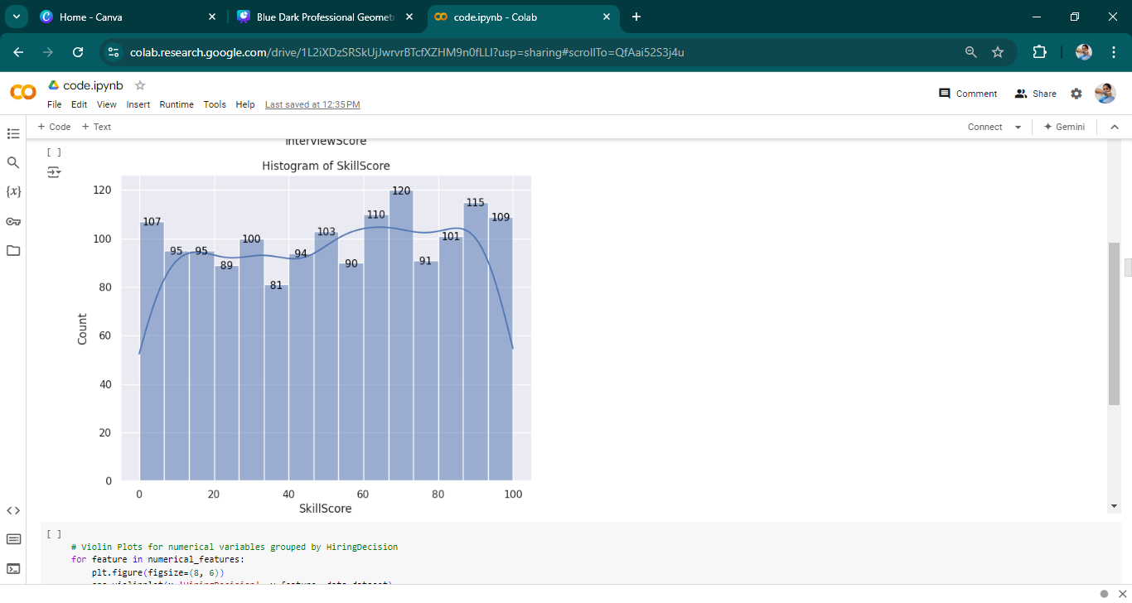
ANALYSIS
The highest skill score is 70 with a count of 120 candidates
The 2nd highest skill score is 90 with 115 count

Slide 18
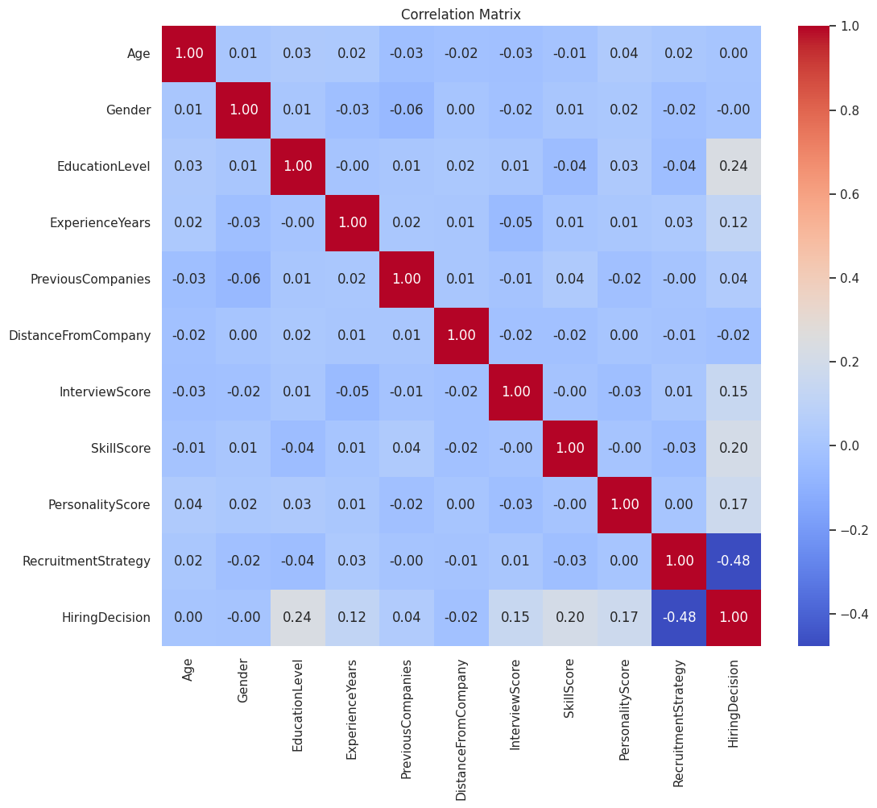
HEATMAP
The heat map reveals significant correlations among features,.
Age closely related to Personality Score. Previous Companies Worked influencing Hiring Decision.
Additionally, a high Skill Score is associated with a greater number of previous work experiences.

Slide 19
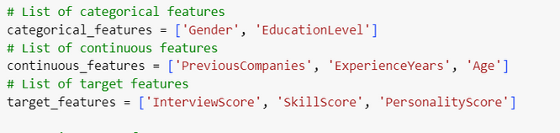
Statistical Analysis
chi-square test | t-test | Anova
Analyzed associations between categorical features and Hiring Decisions. | Compared means of continuous features (ie., numerical feature) with target variable | Conducted variance analysis on binned continuous features and categorical feature with target feature.

Slide 20
Statistical Analysis
chi-square test | t-test | t-test
Gender vs Hiring decision statistic: 0.000977 p-value: 0.975056 There is no significant association | Age vs hiring decision statistic: -0.0717038 p-value: 0.9428535 No significant difference | ExperienceYears vs hiring decision statistic: -4.92998 p-value: 9.677002e-07 There is a significant difference
Education vs Hiring decision statistic: 103.67468 p-value: 2.519032327758e-22 There is a significant association | Distance from company vs hiring decision statistics: 0.65438997 p-value: 0.51302625 No significant difference | Previouscompanies vs hiring decision statistic: -1.72126 p-value: 0.085541 No significant difference
Recruitment Strategy vs Hiring decision statistics: 489.6813086 p-value: 4.645739720431346e-107 There is a significant association | Interview score vs. Hiring decision statistic: -5.525469263 p-value: 4.40540e-07 There is a significant difference | SkillScore vs hiring decision statistic: -8.24586 p-value: 5.44184e-07 There is a significant difference

Slide 21
Statistical Analysis
Anova | Anova | Anova
Gender vs Interview score EducationLevel vs Interview score No significant association | Gender vs Skill score EducationLevel vs Skill score No significant association | Gender vs Personality score EducationLevel vs Personality score No significant association
Previouscompanies vs Interview score agevs Interview score No significant association | Previous companies vs Skill score age vs Skill score ExperienceYear Vs Skill score No significant association | PerviousCompanies vs Personality score ExperienceYear vs Personality score No significant association
ExperienceYear vs Interview score There is a significant association |  | Age vs Personality score There is a significant association

Slide 22
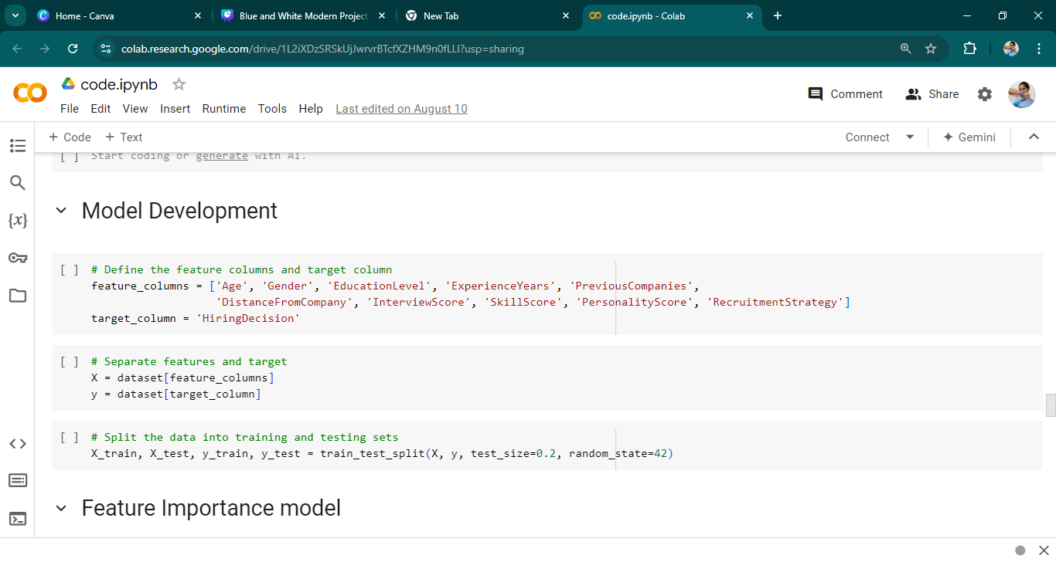
Feature Importance Analysis
Feature columns are independent variables
The target column is the dependent variable, which is the predicted value
The training data and testing data are divided into 80% and 20% of the entire data

Slide 23
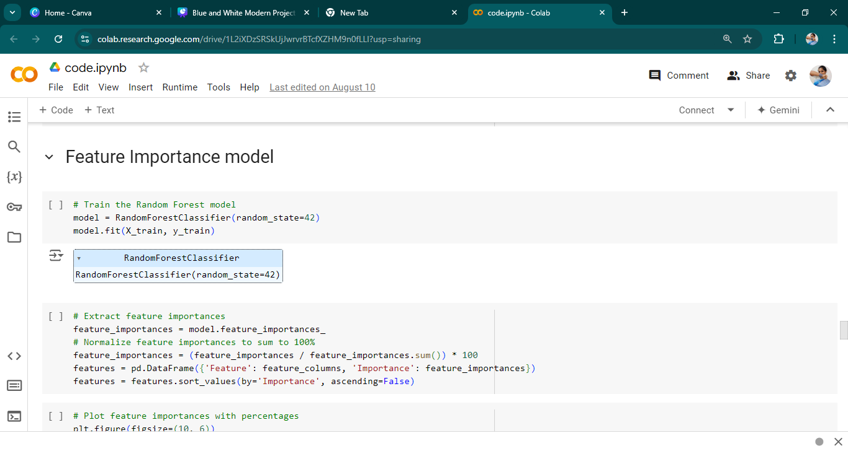
Feature Importance

Slide 24
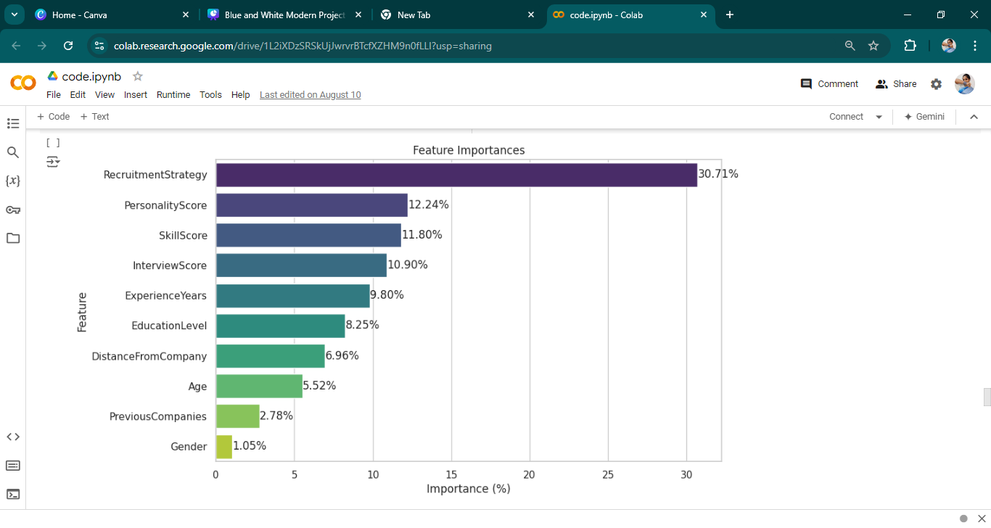
Feature Importance Analysis
Display the importance of each feature in the model (Randomforest).
Here Recruitment Strategy contribute high to the hiring decision.

Slide 25
Model Development
Model | Accuracy
LogisticRegression: | 0.89
SVC | 0.88
DecisionTree | 0.85
RandomForest: | 0.90
XGBoost: | 0.92
Best model is XGBoost with accuracy 92%

Slide 26
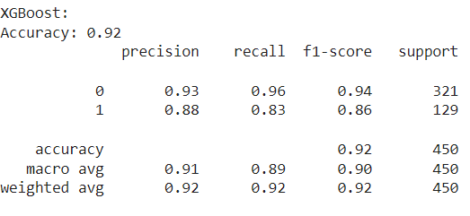
Model Prediction
The model correctly predicts hiring decisions 92% of the time.

Slide 27
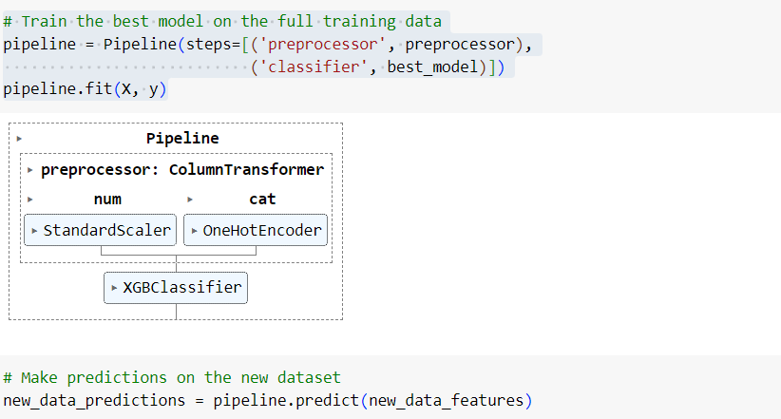
Model Prediction

Slide 28
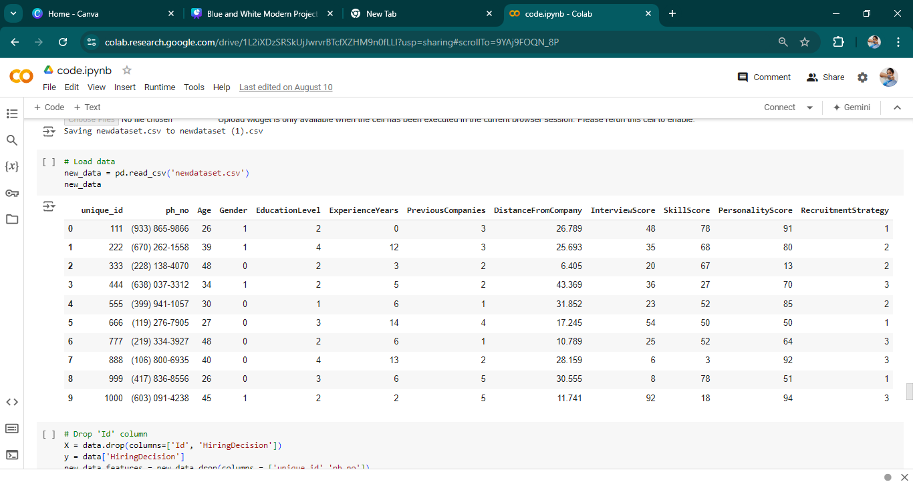
New Data
The new data consists of 10 employee details

Slide 29
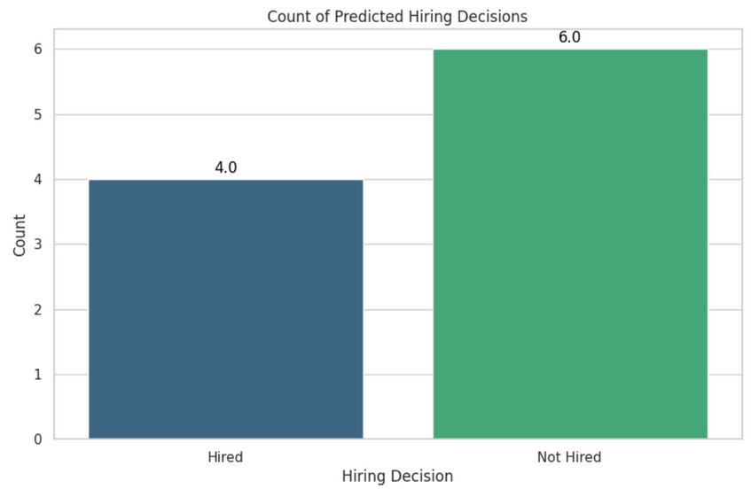
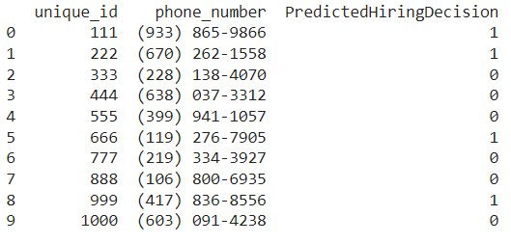
End result
Results:

Slide 30



Findings
Statistical Analysis
(Chi-Square, T-Tests, ANOVA) revealed significant relationships Features with hiring decisions.
Feature Importance Analysis
Feature importance analysis highlighted that education level, recruitment strategy, and key performance metrics like interview, skill, and personality scores significantly influence hiring decisions.
Model Development
Machine learning models effectively predicted hiring decisions, XGBoost as the best model achieved high accuracy in predicting

Slide 31

Conclusion
Chi-Square tests showed no significant impact of gender, while t-tests highlighted the importance of experience years and performance scores in determining hiring outcomes.
ANOVA confirmed that experience influences interview performance, but age and prior company experience had minimal effect.
Overall, demographic factors like age, gender, and geographic proximity play a lesser role, suggesting that refining recruitment strategies to focus on merit-based criteria can lead to a more equitable hiring process.
The built model is 92% accurate and XGBoost is the best model
The new data is predicted and 4 candidates are hired and 6 candidates are not hired

Slide 32


Thank you

